Slide 1

CCAO Data Assessment
IASWorld & 3rd Party Data Model

Slide 2

Agenda
1
2
3
4
IASWorld Data Model
3rd Party Data Model
Discussion for Clarification
Data Model
Scope

Slide 3
Data Model - Subject Area Classification
CCAO’s data provided to us is sourced from IASWorld tables and 3rd party data sources. Both are used to predict the Fair Market Values. For the assessment, we have analyzed all the received data sources’ attributes and their data types. We have come up with a unified data model to store IASWorld and 3rd Party Data.
Upon the completion of our analysis, we have produced 16 fact and 10 dimension tables to model the data. Some of the dimensions are shared between multiple fact tables.
For the purpose of this model, data is grouped into these subject areas:
Property General
Property Transfer
Property Hearing
Property Exemptions
3rd Party Data
Common Dimensions*
Residential features
Commercial features
Land features
Conveyance
Sales
CCRD
Hearing data
Agent information
Commercial Exemptions
Residential Exemptions
Land Exemptions
Census
Spatial
Housing
Environment
Location
Jurisdiction Data
Property addresses
Outbuilding Data
Tax Class
*Common Dimensions consist of tables which are shared across multiple subject areas.

Slide 4
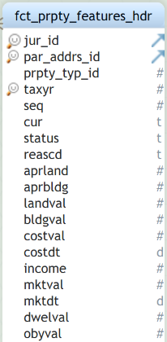
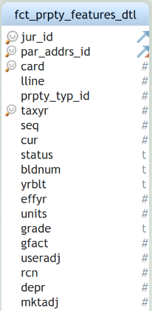
Property Features - Fact Data Model
Data Granularity
FCT_PRPTY_FEATURES_HDR: This fact table will have data at the par_id level.
FCT_PRPTY_FEATURES_DTL: This fact table will have data at the par_id, card and lline level.
Higher
Lower

Slide 5
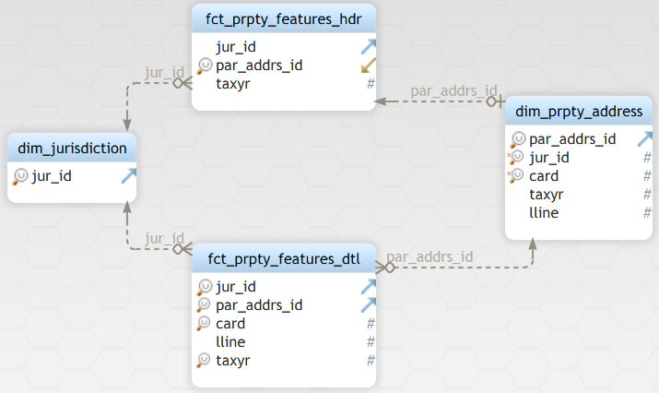
Property Features Fact
Key attributes:
Jurid
parid
lline
landval
bldgval
status
income
prpty_typ

Slide 6
Property Features Fact - Details
Table Name | Type | Description | Comments
FCT_PRPTY_FEATURES_HDR | Fact | This table is collection of par_addrs_id (par_id) level features. | jur_id = 16, par_addrs_id = 10000000000000, tax_yr = 2020
FCT_PRPTY_FEATURES_DTL | Fact | This table is collection of par_addrs_id (par_id), card and lline level features. | jur_id = 16, par_addrs_id = 10000000000000, card = 1, lline = 1, tax_yr = 2020
DIM_PRPTY_ADDRESS | Dimension | This table is collection of all the different property addresses. | par_addrs_id = 10000000000000, jur_id = 16, par_id = 24083090170000 card = 1, lline = 1, tax_yr = 2020
DIM_JURISDICTION | Dimension | This table has jurisdiction information. | jur_id = 16

Slide 7
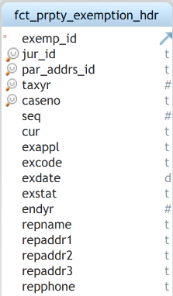
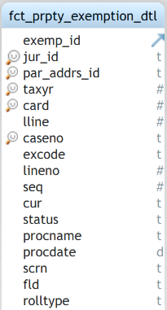
Property Exemptions - Fact Data Model
Data Granularity
FCT_PRPTY_EXEMPTION_HDR: This fact table will have data at the par_addrs_id (par_id) level.
FCT_PRPTY_EXEMPTION_DTL: This fact table will have data at the par_addrs_id (par_id), card and lline level.
Higher
Lower

Slide 8
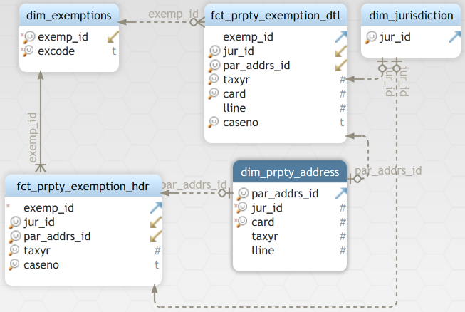
Property Exemptions Fact
Key attributes:
Jurid
parid
lline
exemp_id
caseno
status
seq
procdate

Slide 9
Property Exemption Fact - Details
Table Name | Type | Description | Comments
FCT_PRPTY_EXEMPTION_HDR | Fact | This table is collection of building-level details. | exemp_id = 1000000000, jur_id = 16, par_addrs_id = 10000000000000, tax_yr = 2020, caseno = 123124822
FCT_PRPTY_EXEMPTION_DTL | Fact | This table is collection of line-level details. | exemp_id = 1000000000, jur_id = 16, par_addrs_id = 10000000000000, tax_yr = 2020, card=1 , lline=1, caseno = 123124822
DIM_EXEMPTIONS | Dimension | This table is collection of exemption codes for each tax year. | exemp_id = 1000000000, excode = I-6B
DIM_PRPTY_ADDRESS | Dimension | This table is collection of all the different property addresses. | par_addrs_id = 10000000000000, jur_id = 16, par_id = 24083090170000 card = 1, lline = 1, tax_yr = 2020
DIM_JURISDICTION | Dimension | This table has jurisdiction information. | jur_id = 16

Slide 10
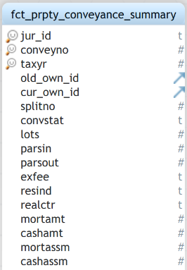
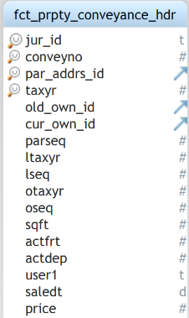
Property Transfer - Fact Data Model
Data Granularity
FCT_PRPTY_CONVEYANCE_SUMMARY: This fact table will have data at the par_addrs_id (par_id) level.
FCT_PRPTY_CONVEYANCE_HDR: This fact table will have data at the par_addrs_id (par_id) level.
Higher
Lower

Slide 11
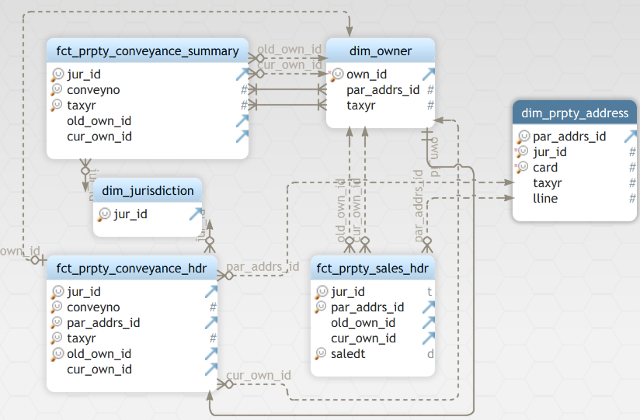
Property Transfer Fact
Key attributes:
Jurid
parid
taxyr
old_own_id
cur_own_id
lots
saledt
stampval

Slide 12
Property Transfer Fact - Details
Table Name | Type | Description | Comments
FCT_PRPTY_CONVEYANCE_SUMMARY | Fact | This table is a collection of conveyance number level, owner and tax year information. | jur_id = 16, conveyno = 3337780, taxyr = 2020, old_own_id = 100000000, cur_own_id = 100000001
FCT_PRPTY_CONVEYANCE_HDR | Fact | This table is collection of par_id, conveyance number, owner and tax year information. | jur_id = 16, conveyno = 3337780, par_addrs_id = 10000000000000, taxyr = 2020, old_own_id = 100000000, cur_own_id = 100000001
FCT_PRPTY_SALES_HDR | Fact | This table is collection of different country codes and description of country for the stores in different country. | jur_id = 16, par_addrs_id = 10000000000000, old_own_id = 100000000, cur_own_id = 100000001, saledt = 2020-01-01 0:00:00
DIM_OWNER | Dimension | This table is collection of owner related data. | own_id, par_addrs_id = taxyr = 2020
DIM_PRPTY_ADDRESS | Dimension | This table is a collection of all the par_ids and their physical addresses. | par_addrs_id = 10000000000000, jur_id = 16, par_id = 24083090170000 card = 1, lline = 1, tax_yr = 2020
DIM_JURISDICTION | Dimension | This table has jurisdiction information. | jur_id = 16

Slide 13
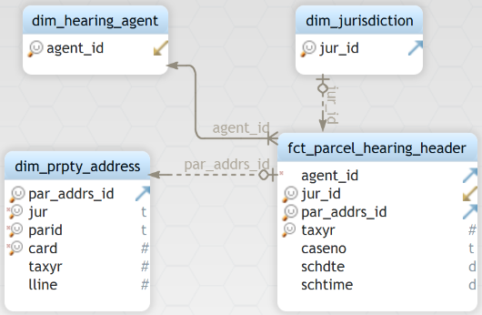
Property Hearing Fact
Key attributes:
Jurid
parid
taxyr
agentid
caseno
schdte
rolltype
hrreas

Slide 14
Property Hearing Fact- Details
Table Name | Type | Description | Example / Comments
FCT_PARCEL_HEARING_HDR | Fact | This table is collection of hearing cases and its associated attributes. | agent_id = 10000, jur_id = 16, par_addrs_id = 10000000000000, taxyr = 2020, caseno = 123124822, schdte = 2020-01-01, schtime = 0:00:00
DIM_HEARING_AGENT | Dimension | This table is collection of hearing agent information. | agent_id = 10000
DIM_PRPTY_ADDRESS | Dimension | This table is a collection of all the par_ids and their physical addresses. | par_addrs_id = 10000000000000, jur_id = 16, par_id = 24083090170000 card = 1, lline = 1, tax_yr = 2020
DIM_JURISDICTION | Dimension | This table has jurisdiction information. | jur_id = 16

Slide 15
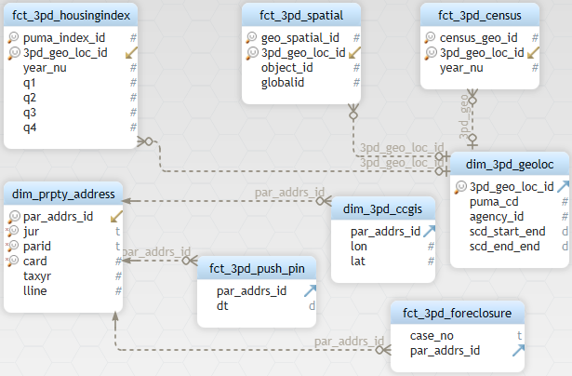
3rd Party Fact
Key attributes:
parid
year_nu
lon
lat
geography_desc
m_tot_pop
f_tot_pop
municipalities
label
faltwork

Slide 16
3rd Party Fact- Details
Table Name | Type | Description | Comment
FACT_3PD_HOUSINGINDEX | Fact | This table contains information about Housing index data sliced by year and quarterly. | puma_index_id = 1, puma_cd = p3401, year_nu=1997,q1 = 88.47
FACT_3PD_SPATIAL | Fact | This table contains information about Spatial data for boundaries of a county or municipality etc | geo_spatial_id = 1, 3po_geo_loc_id = 1, date = ‘2021-09-01’, lon = ‘88.4890’, lat = ‘-23.4567’
FACT_3PD_CENSUS | Fact | This table contains census data. | census_geo_id = 1, geo_cd = 1701, year_nu = 2020, m_top_pop = 601935
FACT_3PD_PUSHPIN | Fact | This table contains information about parcel changes from pushpin website | par_address_id = 1, sector = 1642, dt = ‘2021-09-01’, label = ‘changed’, flatwork = ‘Y’
DIM_3PD_GEOLOC | Dimension | This table contains information about location type like County, School distinct, tract etc | 3pd_geo_loc_id = 1, geography_desc = ‘Cook county, Illinois’, geography_type = ‘County’
DIM_3PD_CCGIS | Dimension | This table contains master data about parel from Cook County parcel data site | par_address_id = 1, lon = ‘88.4890’, lat = ‘-23.4567’, municipality = ‘XYZ’

Slide 17






THANK YOU
www.wavicledata.com
info@wavicledata.com
@wavicledata
@wavicledatallc
@wavicledatallc

